Slide 1
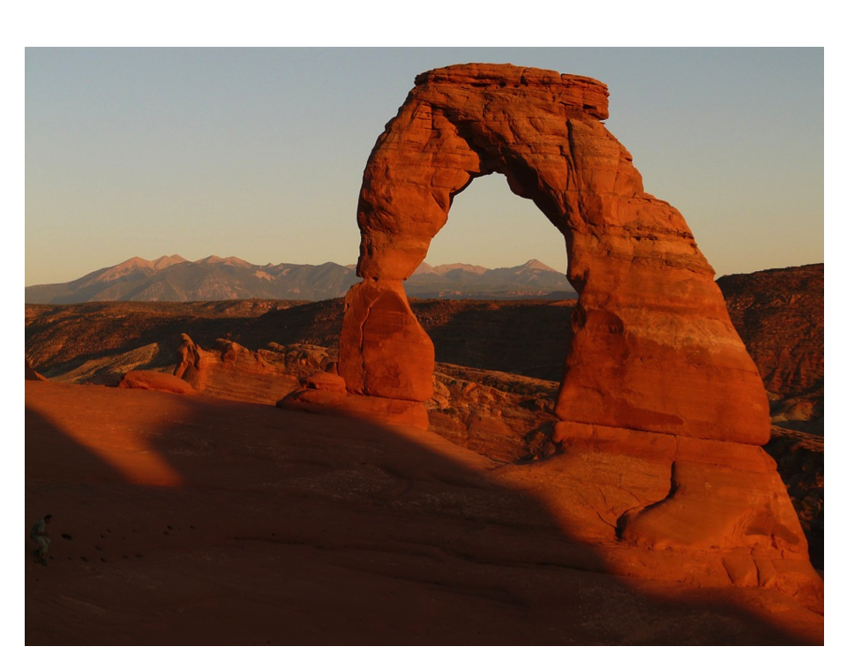
Weathering and Erosion - STEM Activity!

Slide 2
Changes to Earth’s Surface
Over Time
Jump-Off Joe

Slide 3
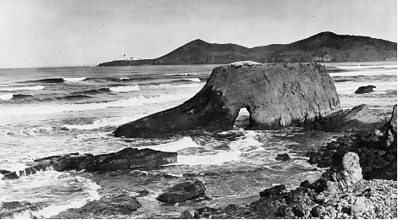
Jump-Off Joe A Sea Stack in Nye Beach, Newport, OR
1890

Slide 4
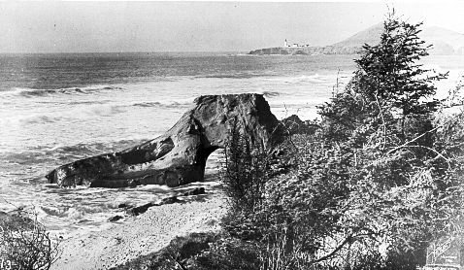
1910
Jump-Off Joe A Sea Stack in Nye Beach, Newport, OR

Slide 5
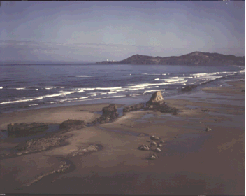
Jump-Off Joe A Sea Stack in Nye Beach, Newport, OR
1970

Slide 6
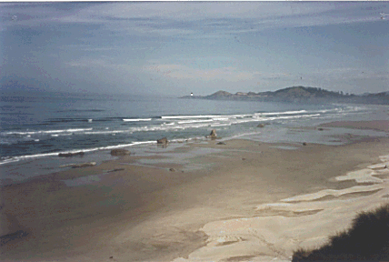
Jump-Off Joe A Sea Stack in Nye Beach, Newport, OR
1990

Slide 7
About the photos:
Erosion of a Sea Stack Over 100 Years period
A Sea Stack is a pillar-like mass of rock detached by wave action from a cliff-lined shore and surrounded by water. http://dictionary.reference.com/browse/sea+stack
Location: Nye Beach, Newport, Oregon
The following photographs show the demise of Jump-Off Joe, a one-hundred-foot-high sandstone formation known as a “sea stack”. In 1890, the sea stack was composed of middle Miocene concretionary sandstone of the Astoria Formation. Yaquina Head on the Horizon is composed of middle Miocene basalt flows and breccia. Note remnant of Pleistocene terrace deposit along the wave cut bench on the stack. Jump-Off Joe was a well-known tourist attraction, but it weathered rapidly. Its arch collapsed in 1916, a few years after the last black-and-white photo, shown below, was taken. There is nothing left of Jump-Off Joe today.
Black-and-white photographs courtesy of Pacific Studios, Newport, Oregon. Dates are approximate. Color photographs taken by Parke D. Snavely, Jr. of the USGS.
https://walrus.wr.usgs.gov/pubinfo/jump.html

Slide 8
Think-Pair-Share
What has happened in these photographs to Jump Off Joe?

Slide 9
How are weathering and erosion interrelated?
How can you slow down coastal erosion on beaches?
Brainstorm with your group and write your ideas in your journal.

Slide 10
Three-Column Notes
PowerPoint- Weathering, Erosion, and Deposition

Slide 11
Scenario:
Florida is defined by its beaches. They are arguably our most important natural resource. But our beaches are losing more and more sand each year, as a result of inlets and jetties, erosion causing hurricanes, and slowly rising sea levels. The maintenance of beach nourishment, which means to refill sand where it has been eroded, is very expensive and an engineering solution must be developed to prevent further damage.

Slide 12
What information do you need to know to complete this challenge?
Some examples:
Who is your client?
What do we need to create?
What have others done to solve this problem?
What are your constraints/limitations?
What type of engineer would solve this problem?

Slide 13
Criteria- You must develop your own working erosion blocking process/ product from everyday items that will prevent erosion after 20 sets of wave activity. Reminder- The process should not disrupt the ecosystem which would include eliminating feeding patterns, introducing new animals, or excess pollution.

Slide 14
Constraints:
Everyone must have exactly three inches of “beach” out of the water and no more to start.
1.5 inches of water will be used as the ocean.
All waves will be created by the teacher lifting the pan opposite the beach, 1 inch off the table and putting it back down twenty times.

Slide 16
As a class, let's think of some ways we could stop erosion.
Now let's look at the materials, do you have any new ideas? Shh, don’t share any yet!

Slide 17
Materials:
Sand
Fabric strips, 8” X 1” strips
Wire mesh strips, 8” X 1” strips
Paper towels
Clay
Paint mixing sticks/ Rulers
Newspaper
Large plastic pans/trays
Gauze
Cotton balls

Slide 18
Imagine:
You will first come up with your idea on your own. Draw it in your journal. Make sure you label what materials you are using.
When everyone is done, you will share your ideas with your group.

Slide 19
Now that everyone in your group has share, you are going to pick the best idea to implement.
I will sign off on your idea and then give you your materials to get started! I can’t sign off on anything unless everyone has the same drawing and materials labeled.

Slide 20
Remember:
You can only shop one time for materials so make you have everything you will need.

Slide 21
When everyone is finished, we will perform the test.
You will record the data in your journal.

Slide 22
Reflect:
Now that you have completed the test, how did you do? What could you have done better?
Now you get the chance to redesign, shop, and build again. Your goal is to improve your data.

Slide 23
Re-Design:
1. You can re-design your product to make it better and that this represented only your first trial. In engineering, a first trial is like a first draft in writing is can be adapted to meet the needs of your client.
2. Think about what you would improve before you start drawing. Why were some designs more successful than others? You will have 10-15 minutes to decide on a re-design.
3. You can get new materials for this re-design and use your previous materials. However, you can only shop one time.

Slide 24
Now that everyone is finished, let’s test! Record the findings in your journal.

Slide 25
Final Reflection:
1. After your re-design, did your group improve their data?
2. What would you change about your final design to be more successful? If nothing, why do you think your design was successful?
3. Why did some groups do better than other groups?
4. Are there any materials you wish you had that you didn't?

